Slide 1
NICOTINE AND CARDIOVASCULAR HEALTH: WHEN POISON IS ADDICTIVE A WORLD HEART FEDERATION POLICY BRIEF
[NAME] [ROLE]
[DATE]

Slide 2
WHF POLICY BRIEF on nicotine
The World Heart Federation Policy Brief Nicotine and Cardiovascular Health: When Poison Is Addictive summarizes the latest evidence on nicotine and heart health.
It aims to raise awareness of the dangers associated with nicotine use, allowing readers to make informed decisions with regard to both traditional and newer tobacco and nicotine products.

Slide 3
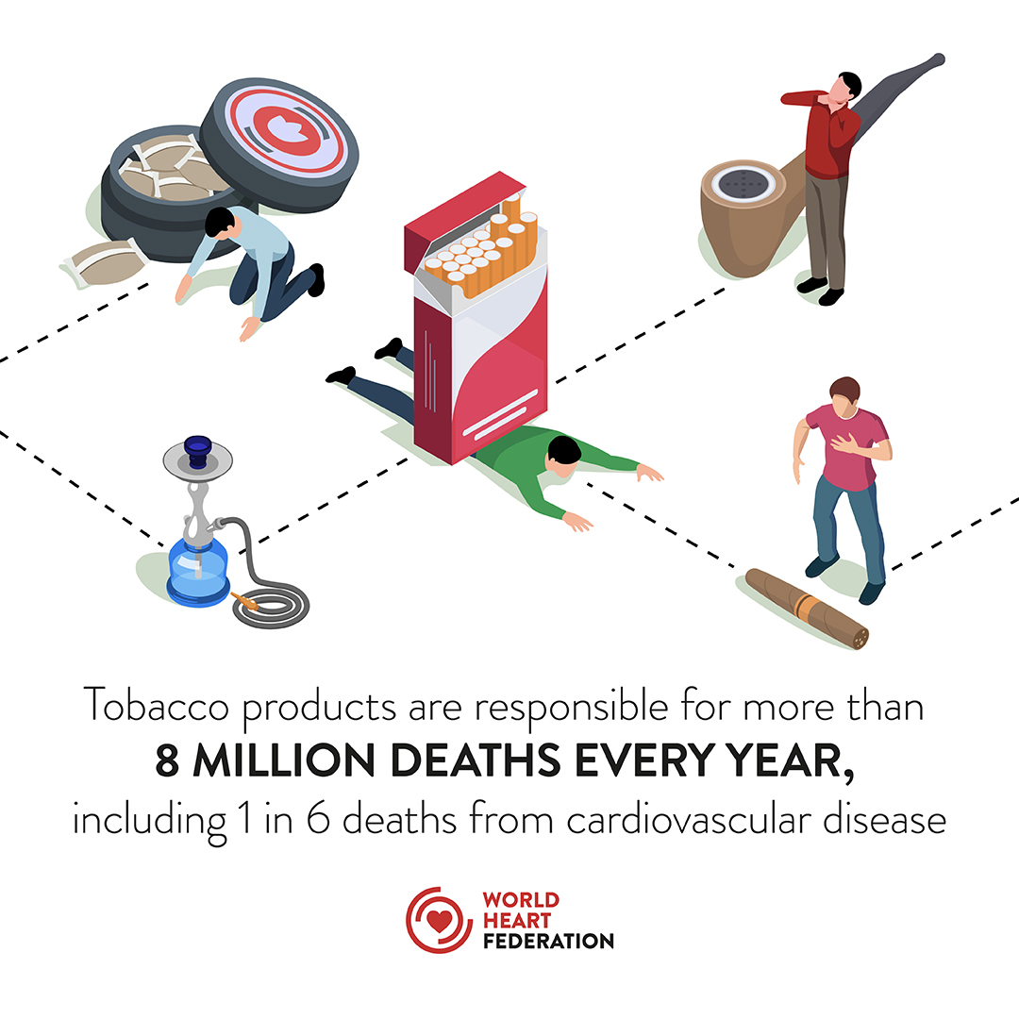
Role of nicotine
Nicotine is universally recognized as the primary addictive component fuelling the continued use of tobacco and nicotine products worldwide.
The toxic compounds found in tobacco smoke and tar are generally cited as the main culprits behind the cardiovascular and respiratory diseases, as well as cancers, associated with tobacco use. However, nicotine is far from innocuous, even on its own.

Slide 4
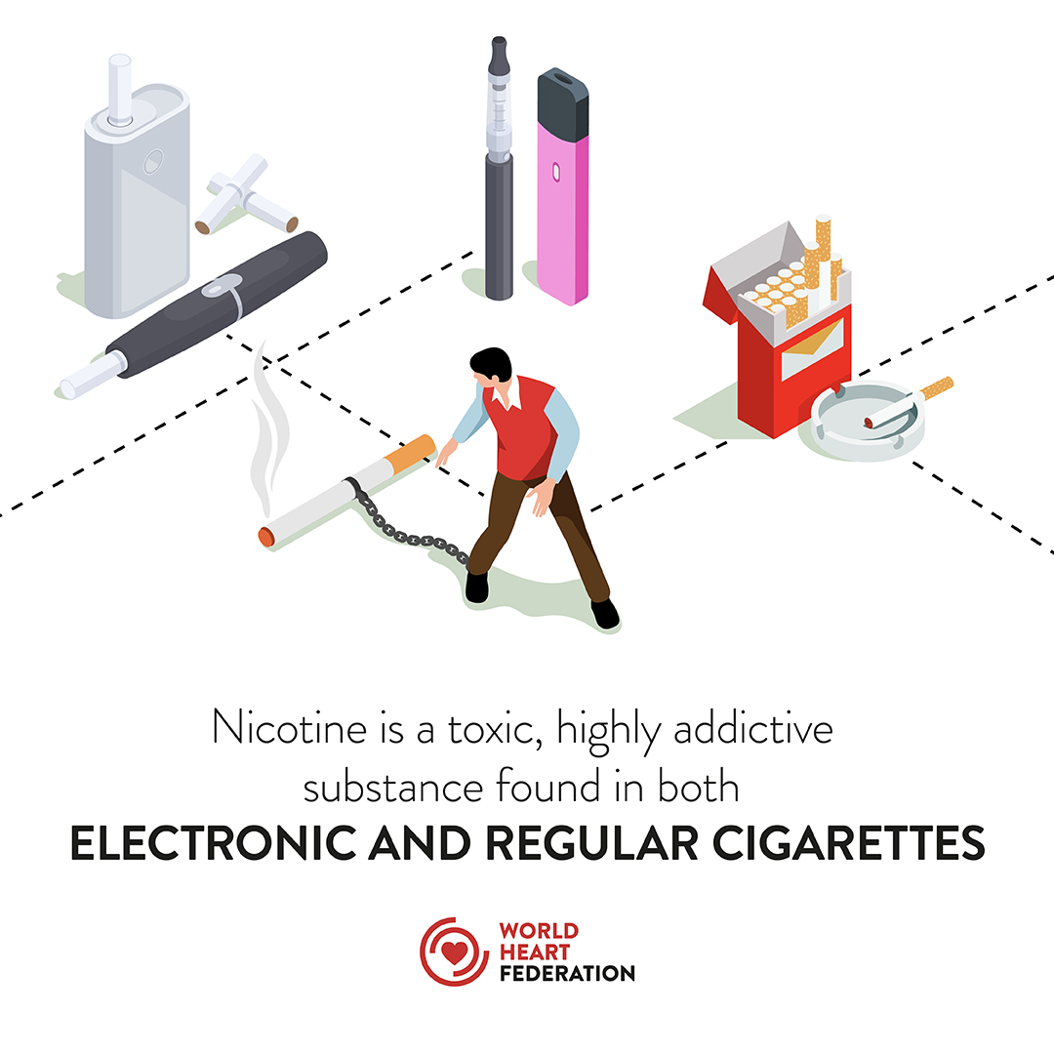
tobacco industry NARRATIVE
The tobacco industry has actively and publicly denied the addictive nature of nicotine for decades.
Nowadays, its strategy has shifted to spread the myth that nicotine is as harmless as caffeine in order to lobby for minimal regulations and promote its newer tobacco and nicotine products.

Slide 5
How can the policy brief help?
The policy brief reviews the latest scientific evidence on nicotine and cardiovascular health.
The policy paper raises awareness about the harmful effects of nicotine on the cardiovascular system.
The policy brief addresses common misconceptions to combat industry misinformation.
The policy paper aims to inform and provide guidance to a wide range of stakeholders.
The policy brief outlines a set of measures that stakeholders can implement to safeguard individual and public health.
The policy paper strengthens the WHF Policy Brief E-Cigarettes: A New Threat to Cardiovascular Health.

Slide 6
Nicotine & cardiovascular health
Nicotine
Acute Nicotine
Chronic Nicotine
…is a highly toxic and addictive substance, associated with increased risks of cardiovascular and respiratory diseases, cancers, as well as other health harms.
…consumption leads to transient elevations in heart rate, vascular tone, and blood pressure.
…consumption is associated with accelerated atherosclerosis, coronary heart disease, congestive heart failure, cardiac dysrhythmias, and thrombosis.
Nicotine
Newer Products
NRTs
…is confirmed to be as addictive as cocaine or heroin. Most smokers would not use tobacco products, if not for nicotine.
…such as e-cigarettes and heated tobacco products are associated with increased risks of heart disease. Modern e-cigarettes can deliver nicotine levels that are comparable to, or higher than, traditional cigarettes.
…are approved first-line medications for the treatment and management of tobacco dependence. In contrast to e-cigarettes, the long-term safety of NRTs is well documented.

Slide 7
EFFECTS OF Nicotine ON THE cardiovascular system
PARAMETERS | EFFECTS OF NICOTINE | POTENTIAL COMPLICATIONS
Heart Rate | Increase | Acute Tachycardia
Blood Pressure | Increase | Acute Hypertension
Coronary Vasodilator Reserve | Decrease | Myocardial Ischemia
Actions on Blood Vessels Cutaneous Vessels Skeletal Muscles Peripheral Vascular Resistance | Vasoconstriction Vasodilatation Increase | Hypertension
Blood Viscosity | Increase | Thrombosis
Platelet Aggregation | Increase | Thrombosis
Production and Release of Nitric Oxide | Decrease | Endothelial Dysfunction
Total and LDL-Cholesterol Levels | Increase | Accelerated Atherosclerosis
Insulin Resistance | Increase | Macrovascular Complications

Slide 8
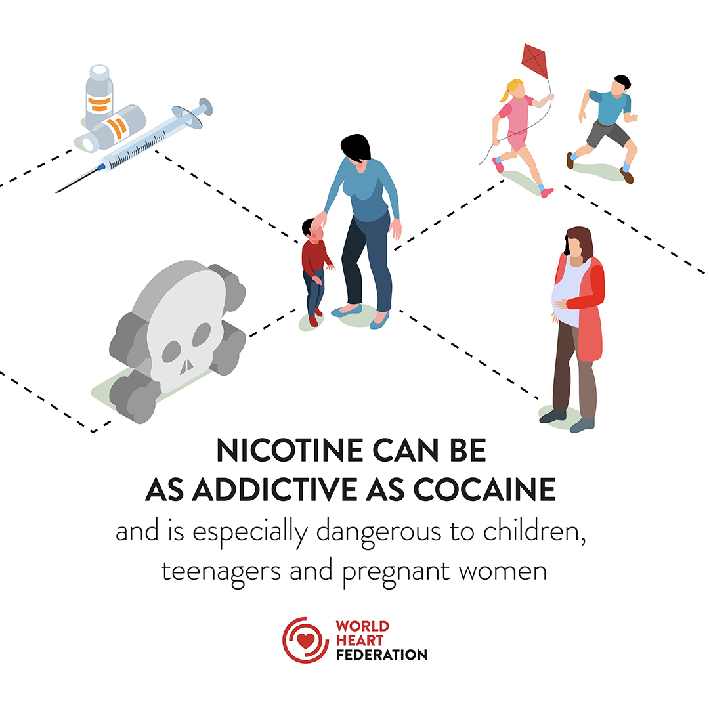
REGULATION OF TOBACCO AND NICOTINE PRODUCTS
A myriad of tobacco and nicotine products remain insufficiently and/or inadequately regulated.
Governments, civil society organizations, healthcare professionals, researchers, and individuals can all play a key role in enacting and/or implementing measures to stop the global tobacco epidemic in its track and protect future generations from new threats.

Slide 9
WHF RECOMMENDATIONS FOR all stakeholders
All people, particularly those with cardiovascular risk factors or disease, should refrain from using tobacco and non-medical nicotine products.
Educators and community leaders should raise public awareness, particularly through educational activities dedicated to special populations: adolescents, young adults, and women.
All health care providers should systematically recommend tobacco cessation and provide tobacco cessation services or referrals to patients as standard of care.
The health care community, civil society, and public should constantly call on governments to implement and enforce regulatory measures that protect public health from tobacco and non-medical nicotine products and from the vested interests of the tobacco industry.
Researchers should study the long-term effects of ENDS, HTP, and other newer recreational nicotine products on cardiovascular health.
Researchers should further probe the drivers of disparities in nicotine and tobacco product use globally and within vulnerable or marginalized communities in a country.
All researchers, academic institutions, and medical and scientific journals should reject tobacco industry collaboration and refrain from publishing and/or presenting studies funded by the tobacco industry.

Slide 10
WHF RECOMMENDATIONS FOR GOVERNMENTS
Regulate by prohibiting or restricting the production, distribution, marketing, sale, and use of tobacco and recreational nicotine products.
Require manufacturers of tobacco and nicotine products to provide evidence of safety of their products.
Regulate the amounts of nicotine delivered by tobacco and nicotine products, including delivery devices.
Introduce or strengthen pro-health excise taxes for tobacco and non-medical nicotine products.
Require standardized packaging with pictorial health warnings and appropriate labelling on tobacco and nicotine products.
Prohibit the addition of flavouring agents in all tobacco and recreational nicotine products, including ENDS.
Prohibit the use of aerosol-generating tobacco and nicotine products in indoor public places, workplaces, and public transports.
Prohibit and monitor all direct and indirect advertising, promotion, and sponsorship of tobacco and recreational nicotine products.
Prohibit and monitor the dissemination of misleading claims on the health effects of tobacco and recreational nicotine products.
Regulate the supply of and retail access to tobacco and nicotine products.

Slide 11
THANK YOU
WORLDHEART.ORG

