Slide 1
A COMPLEX INTERPLAY: NAVIGATING THE CROSSROADS OF TOBACCO USE, CARDIOVASCULAR DISEASE, AND THE
COVID-19 PANDEMIC
A WORLD HEART FEDERATION POLICY BRIEF
NAME, ROLE
DATE

Slide 2

PURPOSE of the policy brief
A Complex Interplay: Navigating the Crossroads of Tobacco Use, Cardiovascular Disease, and the COVID-19 Pandemic
Reviews the latest scientific evidence on the intersection of tobacco use, cardiovascular disease, and the COVID-19 pandemic.
Raises awareness about the triple threats of tobacco use, cardiovascular disease, and COVID-19.
Reflects on the lessons learned from the COVID-19 pandemic.

Slide 3

RELEVANCE OF THE POLICY BRIEF
COVID-19
Remains a significant health threat, with the potential to lead to severe complications and deaths.
Tobacco and COVID-19
Critically impact the outcomes of various health conditions.
Disproportionately affect individuals with co-morbidities, including people living with cardiovascular disease.
A Complex Interplay…
Role of tobacco use as a prognostic factor for severe COVID-19 illness.
Deadly interactions, both direct and indirect, between tobacco use, cardiovascular disease, and COVID-19.

Slide 4
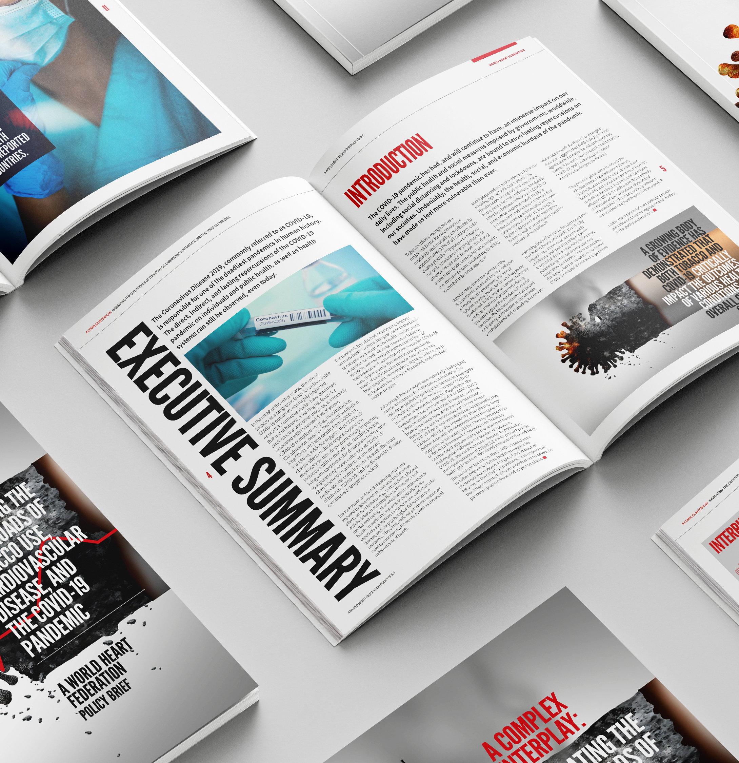
ROLE OF THE POLICY BRIEF
Reader Empowerment
Educates and raises awareness about the deadly interplays between tobacco use, cardiovascular disease, and COVID-19.
Explores how a more robust tobacco control response could have further alleviated the burden of the pandemic.
Policy Guidance
Outlines a set of measures to strengthen tobacco control in a post-COVID-19 pandemic era to better prepare for future health crises.
Proposes a series of measures to ensure the implementation of timely and responsive tobacco control policies in health emergencies.

Slide 5

Tobacco & cardiovascular disease
Tobacco As a Major Risk Factor for Cardiovascular Morbidity and Mortality
Responsible for 17% of all deaths from cardiovascular disease.
Accounts for 21% of all deaths from coronary heart disease.
Acute Effects
Transient increases in heart rate and blood pressure.
Chronic Effects
Accelerated atherosclerosis and thrombosis.
Coronary heart disease, including myocardial infarction.
Stroke.
Peripheral arterial disease.

Slide 6
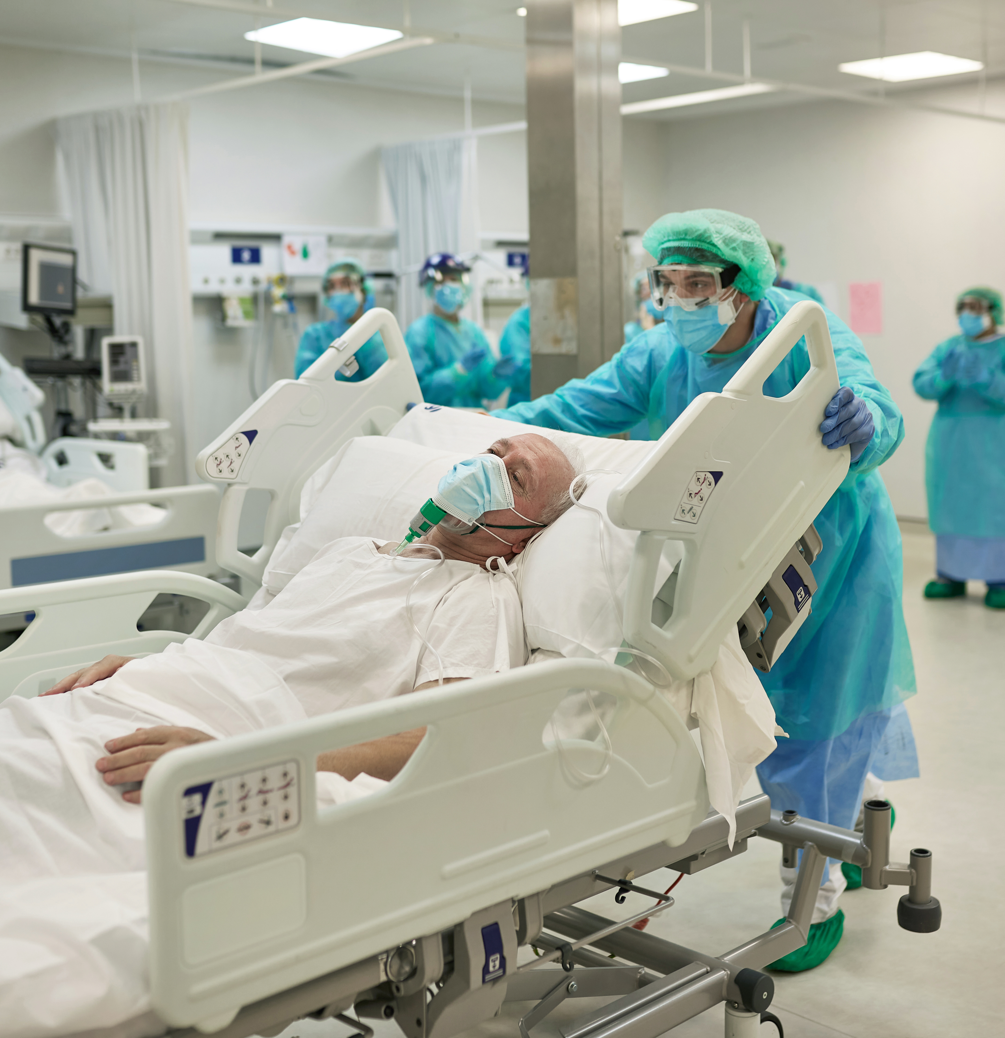
cardiovascular disease & COVID-19
People Living With Cardiovascular Disease and/or Its Associated Risk Factors
Tend to develop more severe COVID-19 illness.
Tend to experience worse COVID-19 outcomes.
Effects of COVID-19 on the Cardiovascular System
Thrombotic cardiovascular complications.
Myocardial injuries, including myocarditis, etc.
Heart failure and exacerbation of its symptoms.
Deterioration of cardiac function.
Myocardial infarction.
Stroke.

Slide 7

Tobacco & covid-19
Tobacco As a Key Determinant of COVID-19 Severity
Tobacco use is strongly associated with increased risks of severe COVID-19 illness, complications, and deaths.
Impact of Tobacco on COVID-19 Outcomes
Increased hospitalisation rates, including prolonged duration.
Increased intensive care unit admission, including need for mechanical ventilation.
Elevated risks of experiencing “long COVID”.
Elevated mortality rates.
Many underlying diseases associated with severe COVID-19 illness, such as cardiovascular disease, are also closely related to tobacco use.

Slide 8
A COMPLEX INTERPLAY

Slide 9

IMPACTS of Lockdowns and social distancing
Impact on Mental Health
Stress, anxiety, distress, etc.
Rise in cases of depression and suicides.
Impact on Lifestyle
Unhealthy diets.
Physical inactivity.
Alcohol use.
Impact on Smoking Behaviour
Surge in tobacco consumption in some countries marked by increases in frequency, quantity, dependence, and relapses.
Shifts in usage pattern across countries and regions.

Slide 10
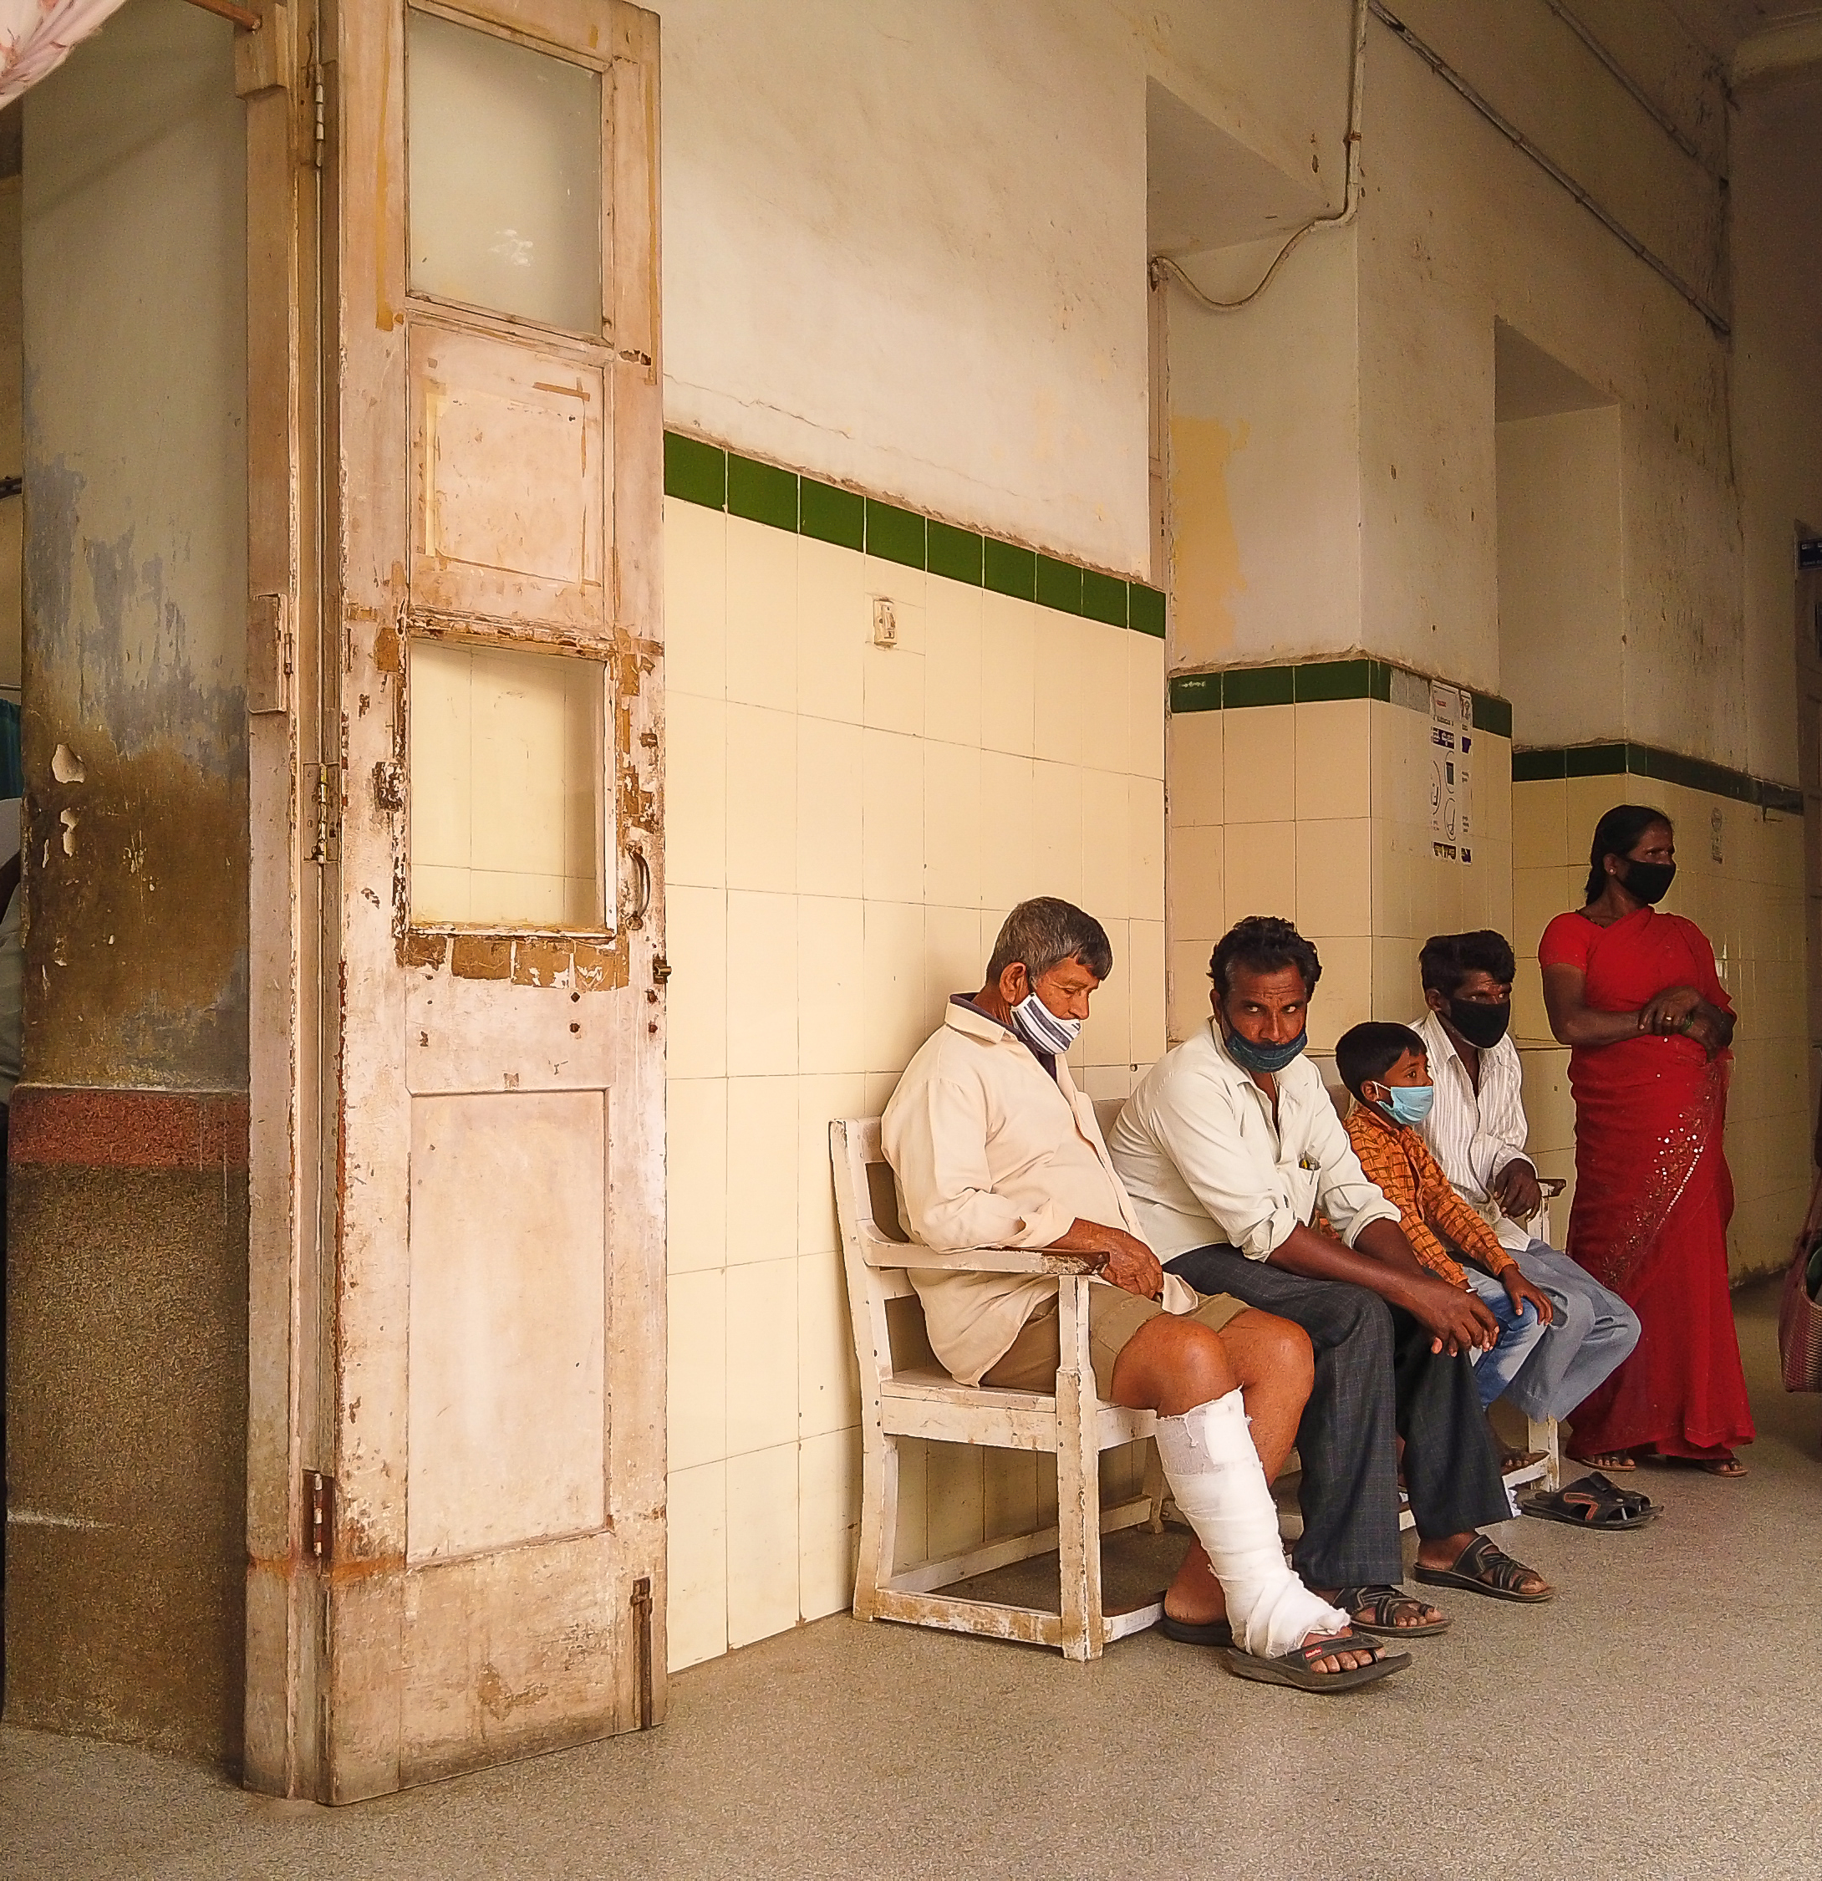
Impacts of the pandemic on health systems
Noncommunicable Diseases Services
Disruptions of services reported in 90% of countries.
Interruptions of cardiovascular disease services at all levels, including prevention, diagnosis, treatment, hospitalizations for cardiovascular events, rehabilitation, etc.
Decrease in attendance for outpatient care services.
Levels of cardiovascular disease care activity remain below pre-pandemic standards in some countries.
Tobacco Cessation Services
Interruption of tobacco cessation services.
Drop in sales of nicotine replacement therapies.
Innovations in digital health solutions.

Slide 11

TOBACCO CONTROL in the context of the pandemic
Implementation of Tobacco Control Policies
Temporary measures, such as smoke-free policies and bans on tobacco sales, to limit the potential spread of the virus.
Missed Opportunities
Interruption of tobacco cessation services.
Measures were withdrawn as restrictions eased.
Several countries classified tobacco as essential commodities.
Lessons Learned
Countries displayed political will and capacity to enact life-saving tobacco control measures to safeguard public health.
A more robust tobacco control response could have further alleviated the burden of the pandemic.

Slide 12

Tobacco industry INTERFERENCE
Tobacco Industry Tactics
Misinformation campaigns to promote alleged protective effects of nicotine against SARS-CoV-2 infection.
Corporate social responsibility activities, such as donations, to re-establish its image.
Interference in government decisions to undermine pandemic-related tobacco control policies.
Tobacco Industry Agenda
To lobby against tobacco control laws.
To promote its tobacco and nicotine products.
To influence public opinion on the links between tobacco use and severe COVID-19 illness.

Slide 13

Whf recommendations
For Healthcare Professionals and Institutions
Document systematically the use of tobacco and nicotine products in medical records.
Study the interplays between tobacco use, cardiovascular disease, and emerging SARS-CoV-2 variants.
Ensure availability, accessibility, and affordability of tobacco cessation services, including during health emergencies.
Leverage digital health solutions to enhance tobacco cessation services.

Slide 14
Whf recommendations
For Governments and Civil Society
Accelerate the implementation and expansion of tobacco control policies.
Maintain tobacco control policies instituted during health emergencies.
Prioritize health equity in national pandemic responses.
Implement Article 5.3 of the WHO FCTC on Conflicts of Interests, recognizing that there is an irreconcilable conflict between the tobacco industry’s interests and public health policy interests.
Monitor and oversee the activities of the tobacco industry during health emergencies.
Implement Article 6 of the WHO FCTC on Price and Tax Measures to Reduce the Demand for Tobacco.
Implement Article 8 of the WHO FCTC on Protection from Exposure to Tobacco Smoke.
Implement Article 12 of the WHO FCTC on Education, Communication, Training, and Public Awareness.
Implement Article 14 of the WHO FCTC on Demand Reduction Measures Concerning Tobacco Dependence and Cessation.
Countries that are not signatories to the WHO Framework Convention on Tobacco Control can still implement its measures.

Slide 15

THANK YOU
WORLDHEART.ORG

