Slide 1


WORLD HEART VISION 2030:
DRIVING POLICY CHANGE
WHF – October 2022

Slide 2
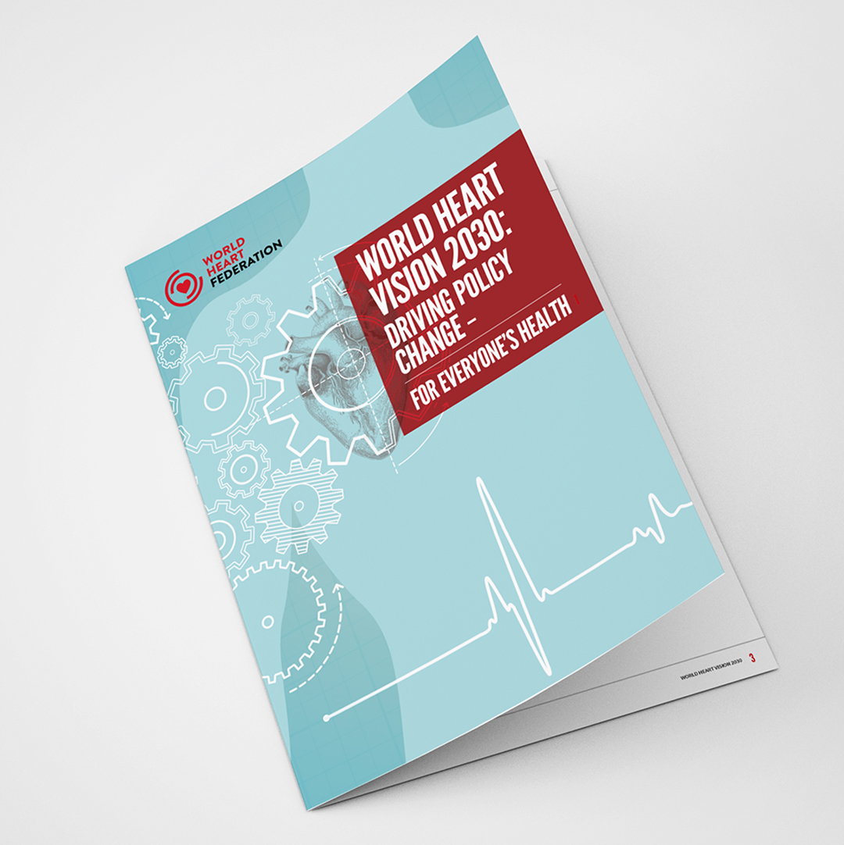
WHY LAUNCH A WORLD HEART VISION 2030?
Collective goals:
WHF initiated The World Heart Vision 2030 to capture paths to better cardiovascular health in the coming decade and help close gaps in equity.
The World Heart Vision involves everyone in ambitious yet achievable steps to further work across sectors and with policymakers.
It provides a platform for spreading awareness, promoting advocacy and developing partnerships.
It presents implementable policy recommendations for the coming years.
It guides advocacy and communications efforts.
It emphasizes using what we know and building on knowledge and innovation.

Slide 3




WHAT IS THE ESSENCE OF THE WORLD HEART VISION 2030
4 Paths:
Paving the way for cardiovascular health equity
Fostering timely implementation of knowledge
Leveraging innovation and technologies for cardiovascular health
Placing cardiovascular health at the heart of health and climate policies
Each path has a set of key messages and calls to action.

Slide 4
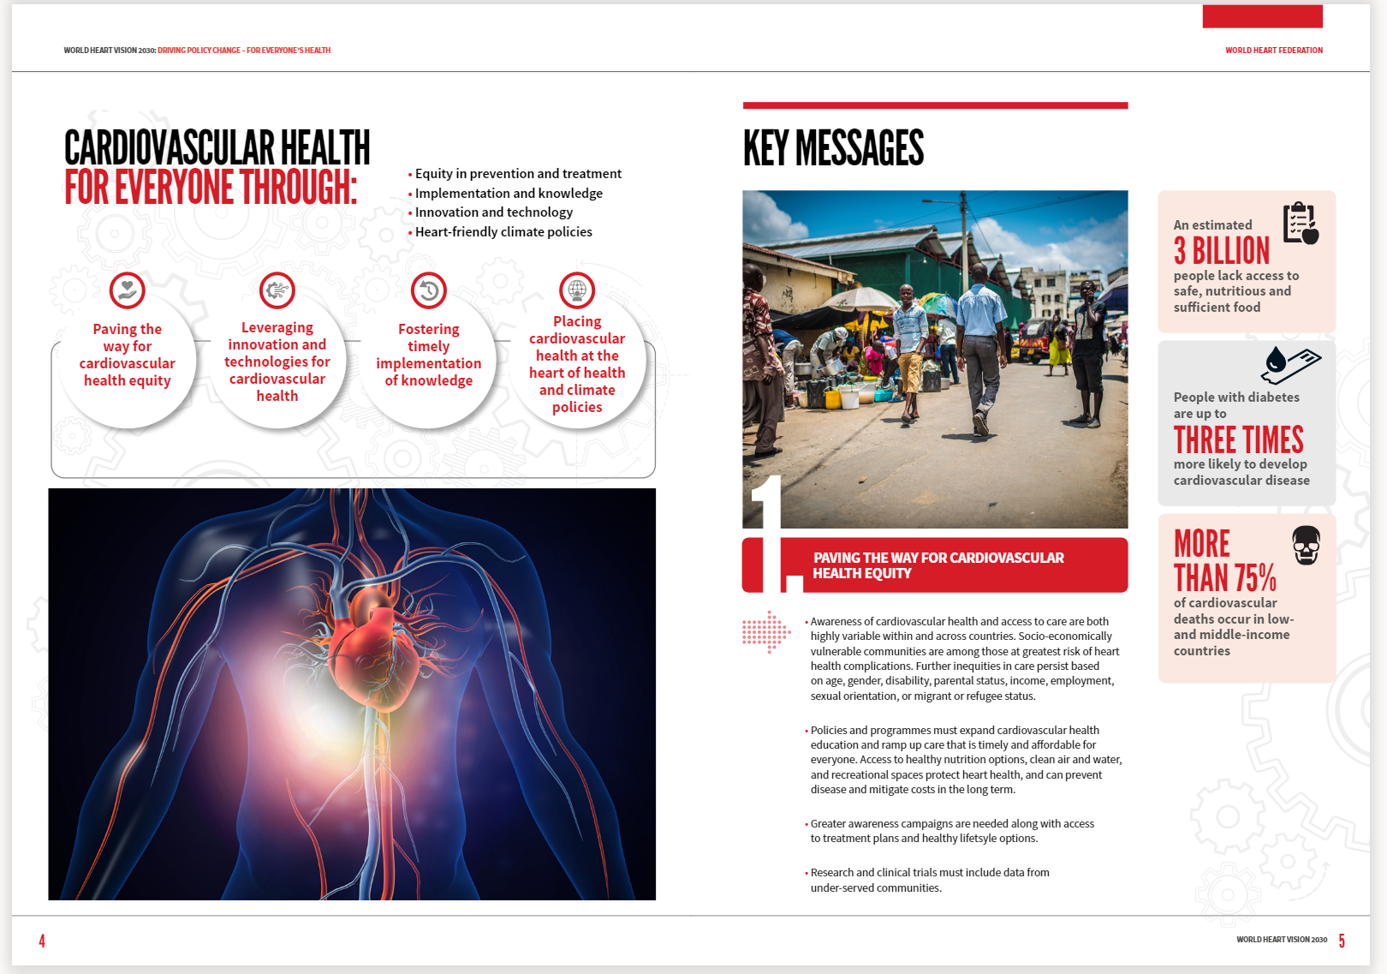
PAVING THE WAY FOR CARDIOVASCULAR HEALTH EQUITY
Path 1
Awareness of cardiovascular health and access to care are both highly variable within and across countries. Socio-economically vulnerable communities are among those at greatest risk of heart health complications.
Policies and programmes must expand cardiovascular health education and ramp up care that is timely and affordable for everyone. Access to healthy nutrition options, clean air and water, and recreational spaces protect heart health, and can prevent disease and mitigate costs in the long term.
Research and clinical trials that include data from under-served communities along with awareness campaigns are needed to develop treatment plans, access, and healthy lifestyle options.

Slide 5
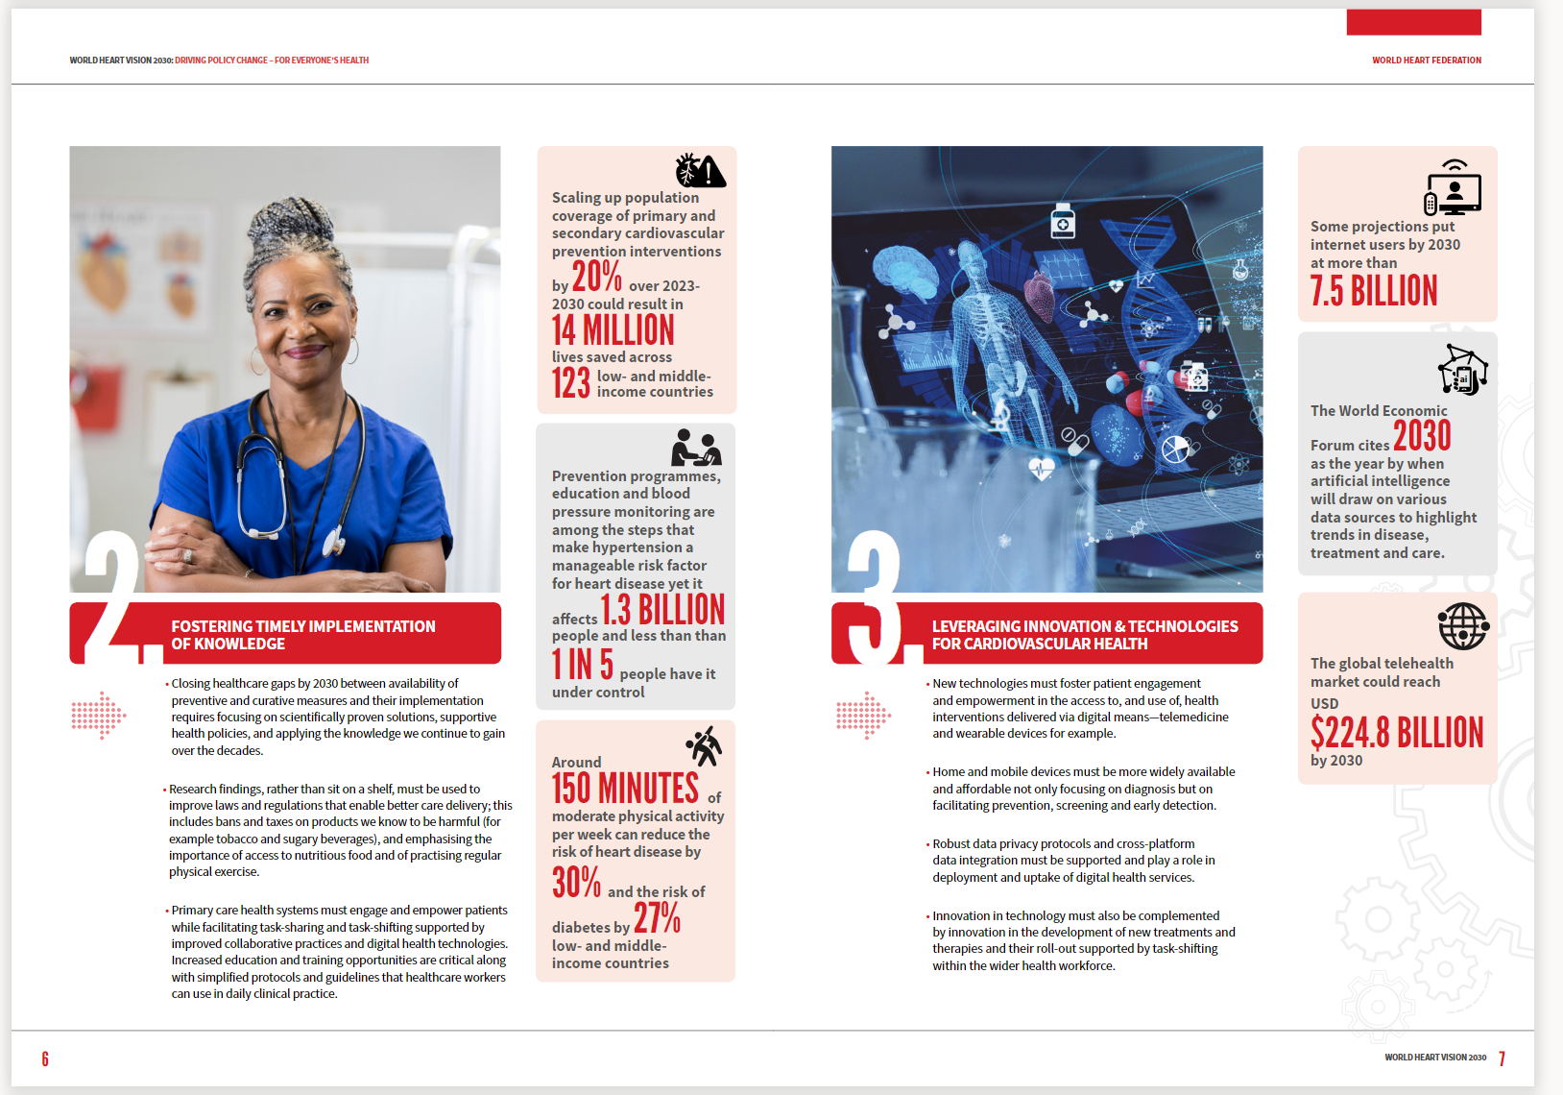
FOSTERING TIMELY IMPLEMENTATION OF KNOWLEDGE
Path 2
Closing healthcare gaps by 2030 between preventive and curative measures requires focusing on scientifically proven solutions, supportive health policies, and applying continual knowledge gained.
Research findings, rather than sit on a shelf, must be used to improve laws and regulations; this includes bans and taxes on products we know to be harmful for example tobacco and sugary beverages.
Primary care health systems must engage and empower patients while facilitating task-sharing and task-shifting. Increased education and training opportunities are critical along with simplified protocols and guidelines that healthcare workers can use in daily clinical practice.

Slide 6
LEVERAGING INNOVATION & TECH FOR CV HEALTH
Path 3
New technologies must foster patient engagement and empowerment through interventions via digital means—telemedicine and wearable devices for example.
Home and mobile devices must be more widely available and affordable for diagnosis and for facilitating prevention, screening and early detection.
Robust data privacy protocols and cross-platform data integration must be supported.
Innovation in technology must also be complemented by innovation in new treatments and therapies and their roll-out supported by task-shifting within the wider health workforce.

Slide 7
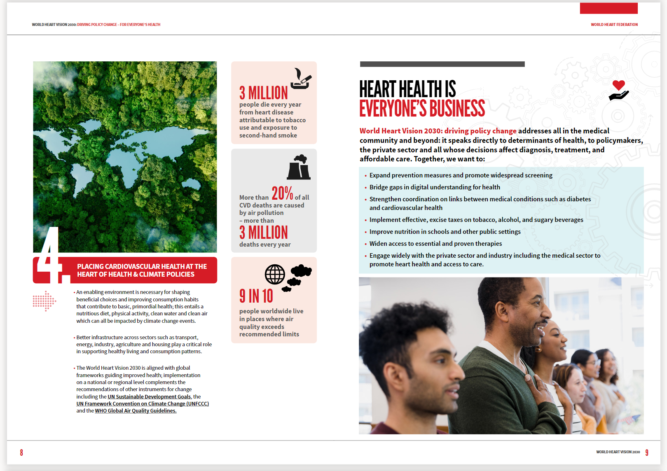
PLACING CV HEALTH AT THE HEART OF HEALTH & CLIMATE POLICIES
Path 4
An enabling environment is necessary for shaping choices and consumption habits that contribute to primordial health: a nutritious diet, physical activity, clean water and clean air which can all be impacted by climate change events.
Better infrastructure across sectors such as transport, energy, industry, agriculture and housing play a critical role in supporting healthy living and consumption patterns.
The World Heart Vision 2030 is aligned with global frameworks guiding improved health; implementation on a national or regional level complements the recommendations of other instruments for change including the UN Sustainable Development Goals, the UN Framework Convention on Climate Change (UNFCCC) and the WHO Global Air Quality Guidelines.

Slide 8
How was the World Heart VISION 2030 put together
Consultative process:
Several rounds of broad consultation and panel questions
Questions posed related to problems, priorities and barriers on the paths to heart health
Participants provided one sentence to describe their vision for cardiovascular health
7 panel discussions were held with:
  WHF Science Committee
  WHF Advocacy Committee
  WHF Past Presidents
  WHF Emerging leaders
  WHF Key Opinion Leaders (KOLs)
  KOLs from the medical device sector

Slide 9
For whom is World Heart Vision 2030
GOVERNMENTS
HEALTH PROFESSIONALS
CIVIL SOCIETY
PRIVATE SECTOR
PHARMACEUTICAL SECTOR
MEDICAL TECHNOLOGY AND DEVICES SECTOR
PATIENT ORGANIZATIONS
ACADEMIC, RESEARCH AND EDUCATION COMMUNITY

Slide 10
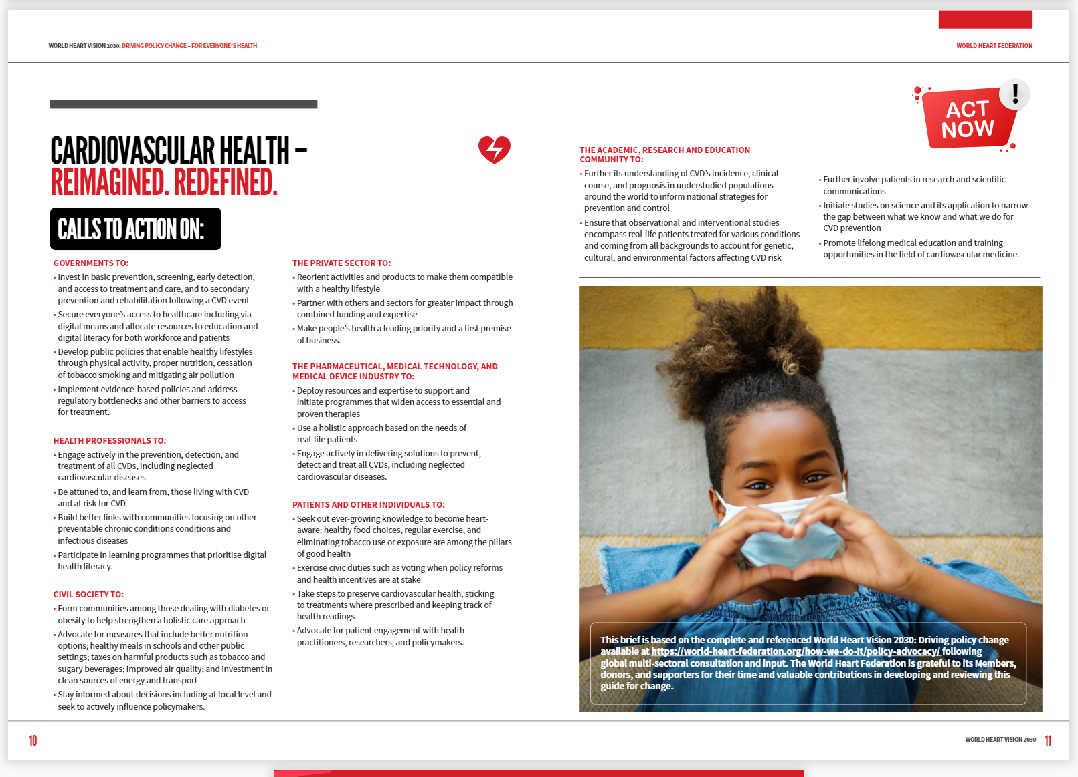
World Heart Vision 2030: Driving Policy Change
Some toplines:
Expand prevention measures and promote widespread screening
Bridge gaps in digital understanding for health
Strengthen coordination on links between medical conditions such as diabetes and cardiovascular health
Implement taxes on harmful products such as tobacco and sugary beverages
Widen access to essential and proven therapies
Engage widely with the private sector and industry including the medical sector to promote heart health and access to care.

Slide 11
Where to find out more about World Heart Vision 2030
DOWNLOAD
World Heart Vision 2030: Driving Policy Change
DOWNLOAD
World Heart Vision 2030 Brief: Driving Policy Change
READ
The media statement
Watch this space and read our upcoming editorial in the Global Heart Journal

Slide 12

THANK YOU
WORLDHEART.ORG

